Slide 1
Christmas Picture Riddles
Can you solve the riddles?

Slide 2
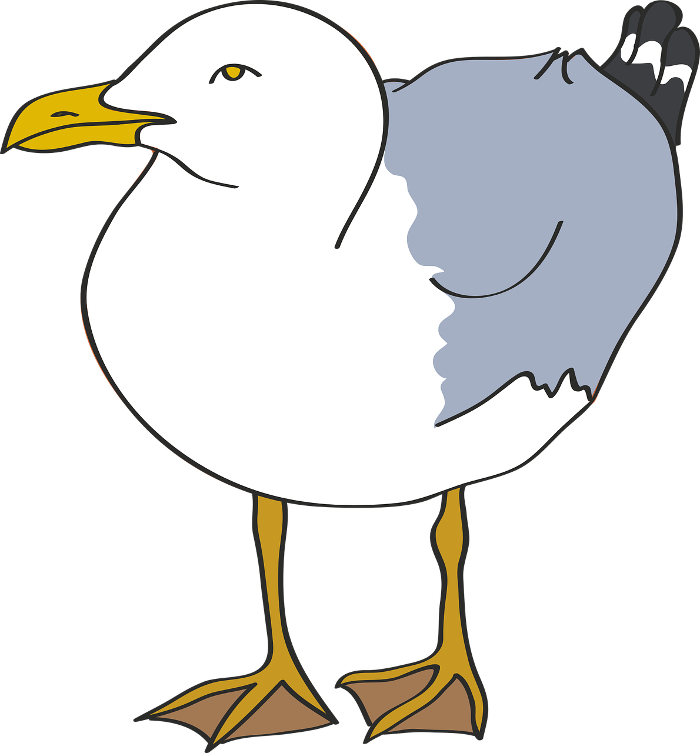
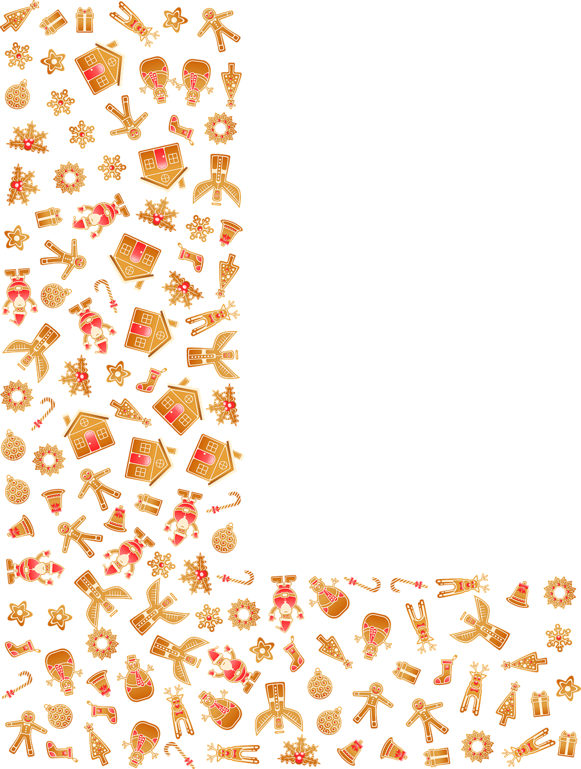
B

Slide 3
Jingle Bells
Answer
chin + gull
b + Ls

Slide 4
S
L

Slide 5
Silent Night
Answer
s + eye + l + ant
knight

Slide 6
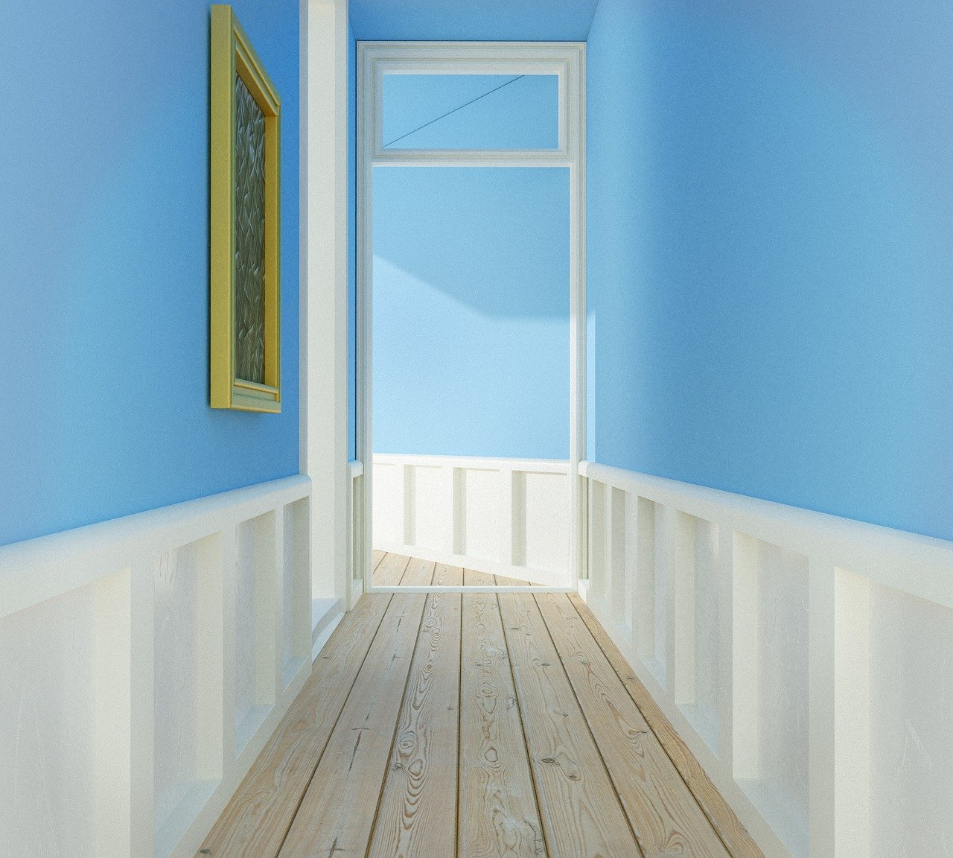

Slide 7
holidays
Answer
hall + lid + As

Slide 8
D

Slide 9
reindeer
Answer
rain + d + ear

Slide 10
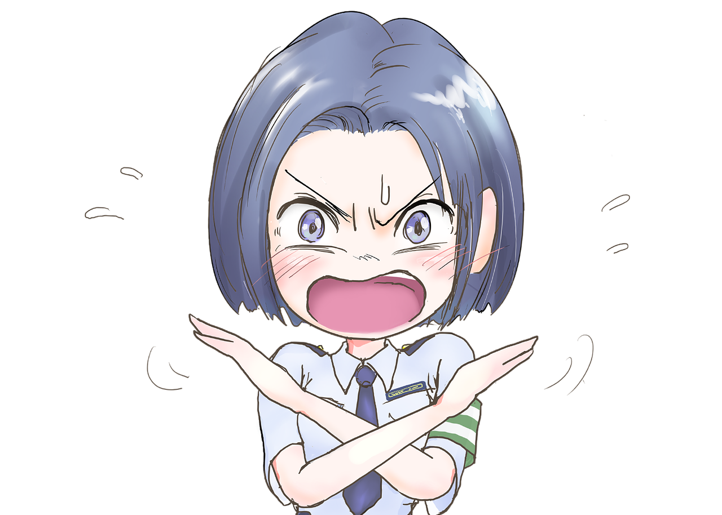

Slide 11
ornaments
Answer
oar + no + mints

Slide 12
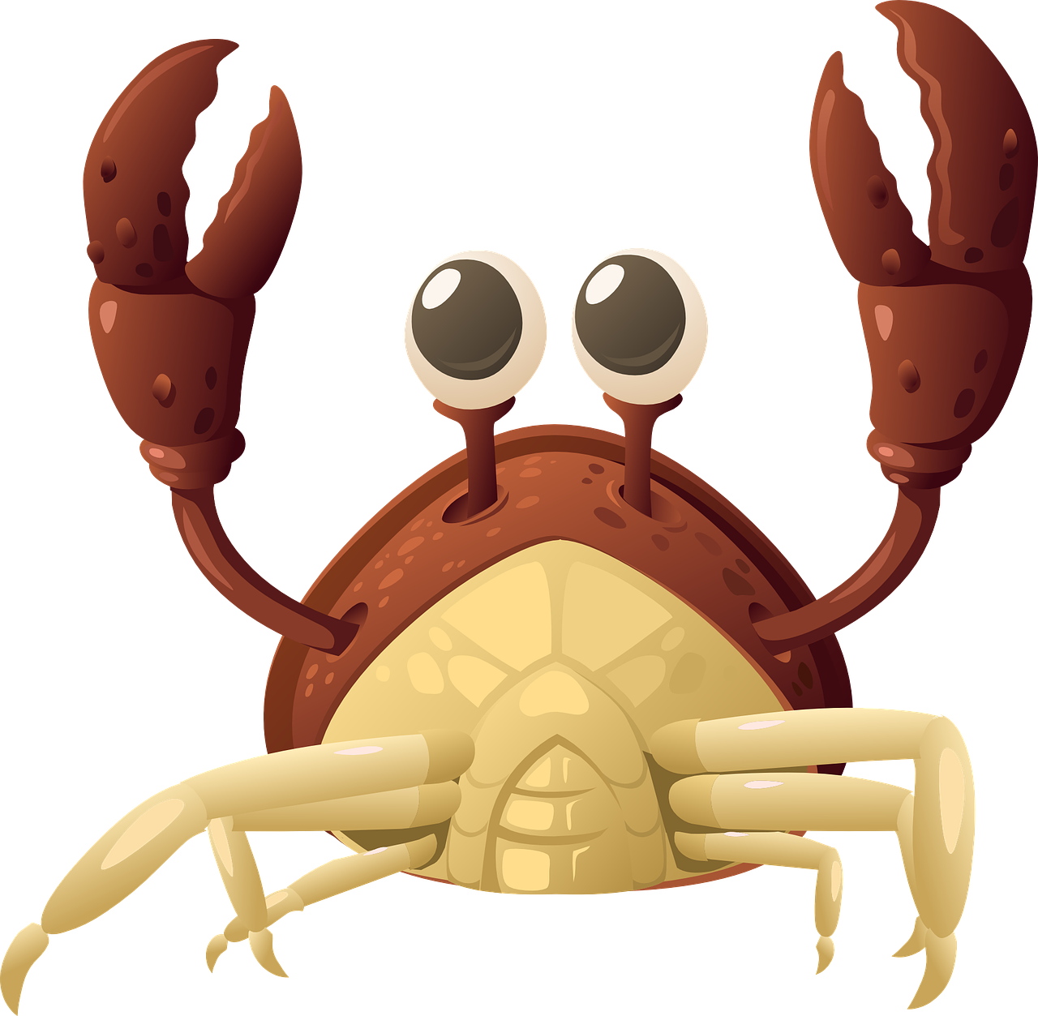
A

Slide 13
Santa Claus
Answer
sand + a
claws

Slide 14
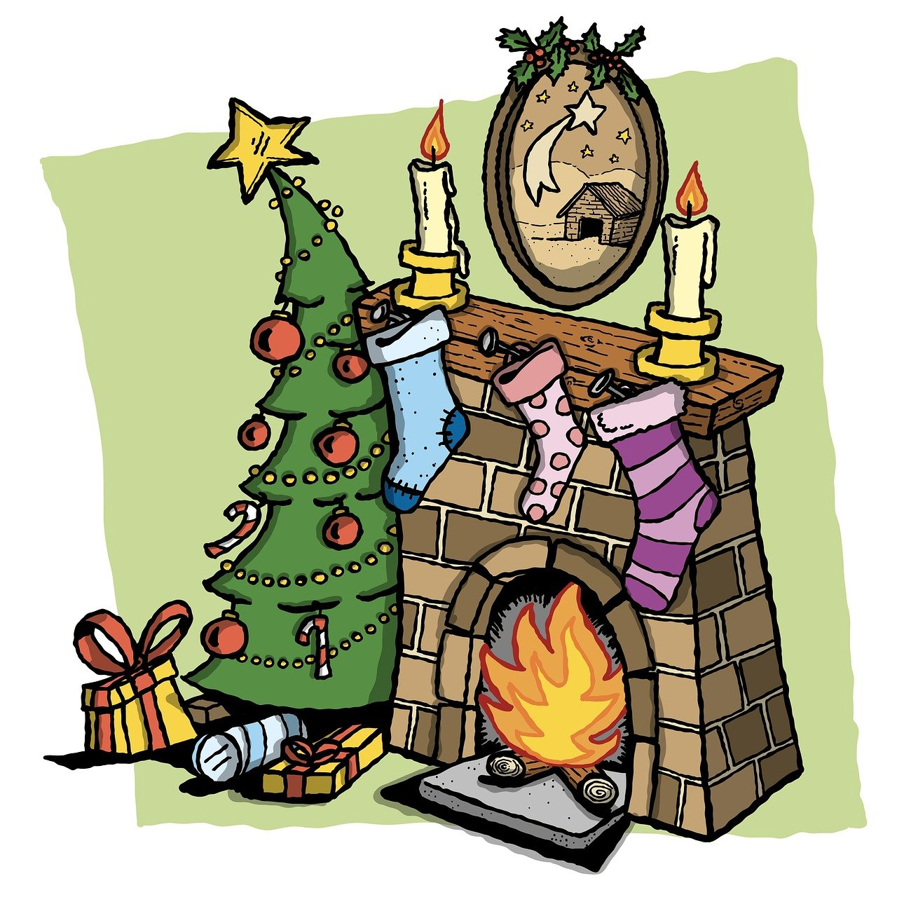
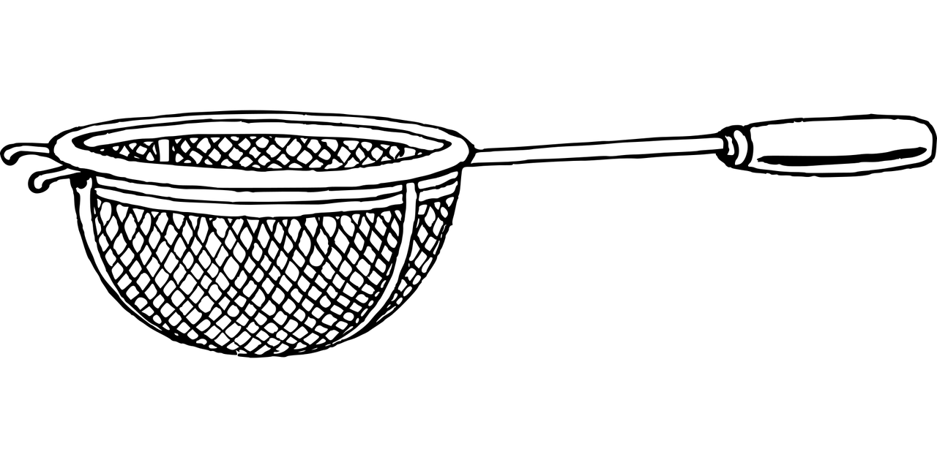
What holiday is this?

Slide 15
Christmas Eve
Answer
Christmas
sieve

Slide 16
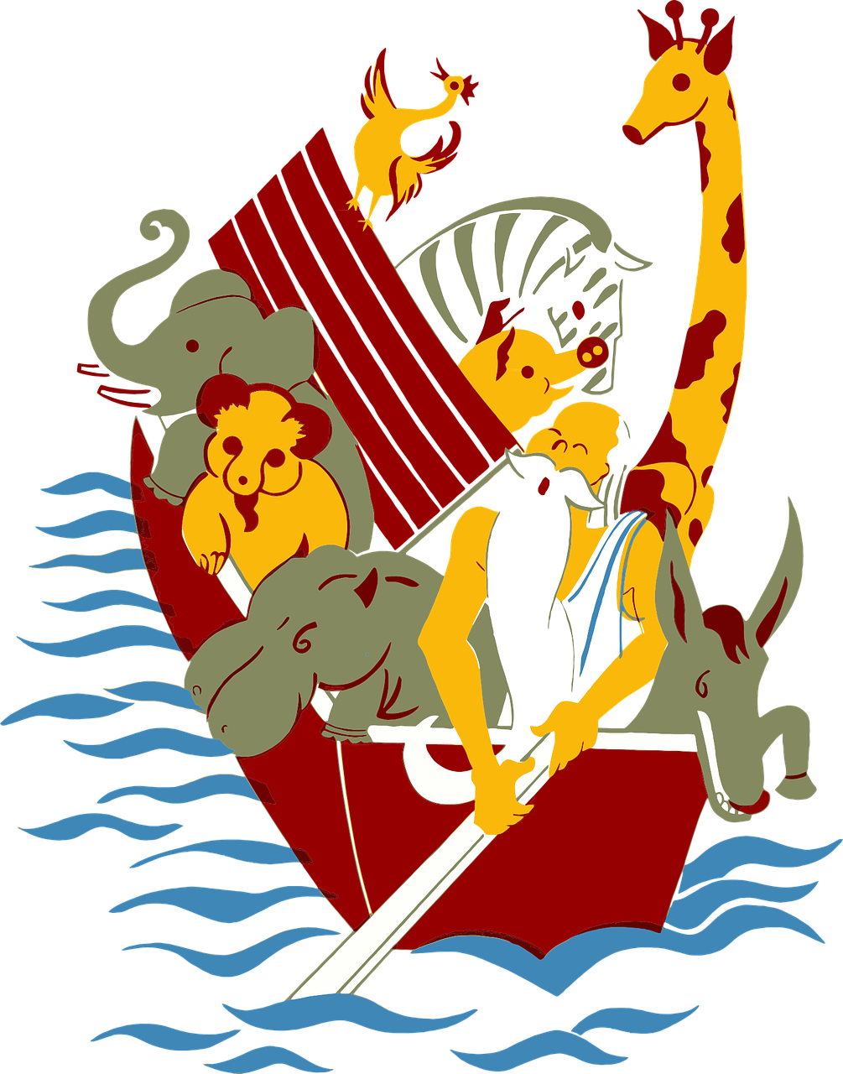
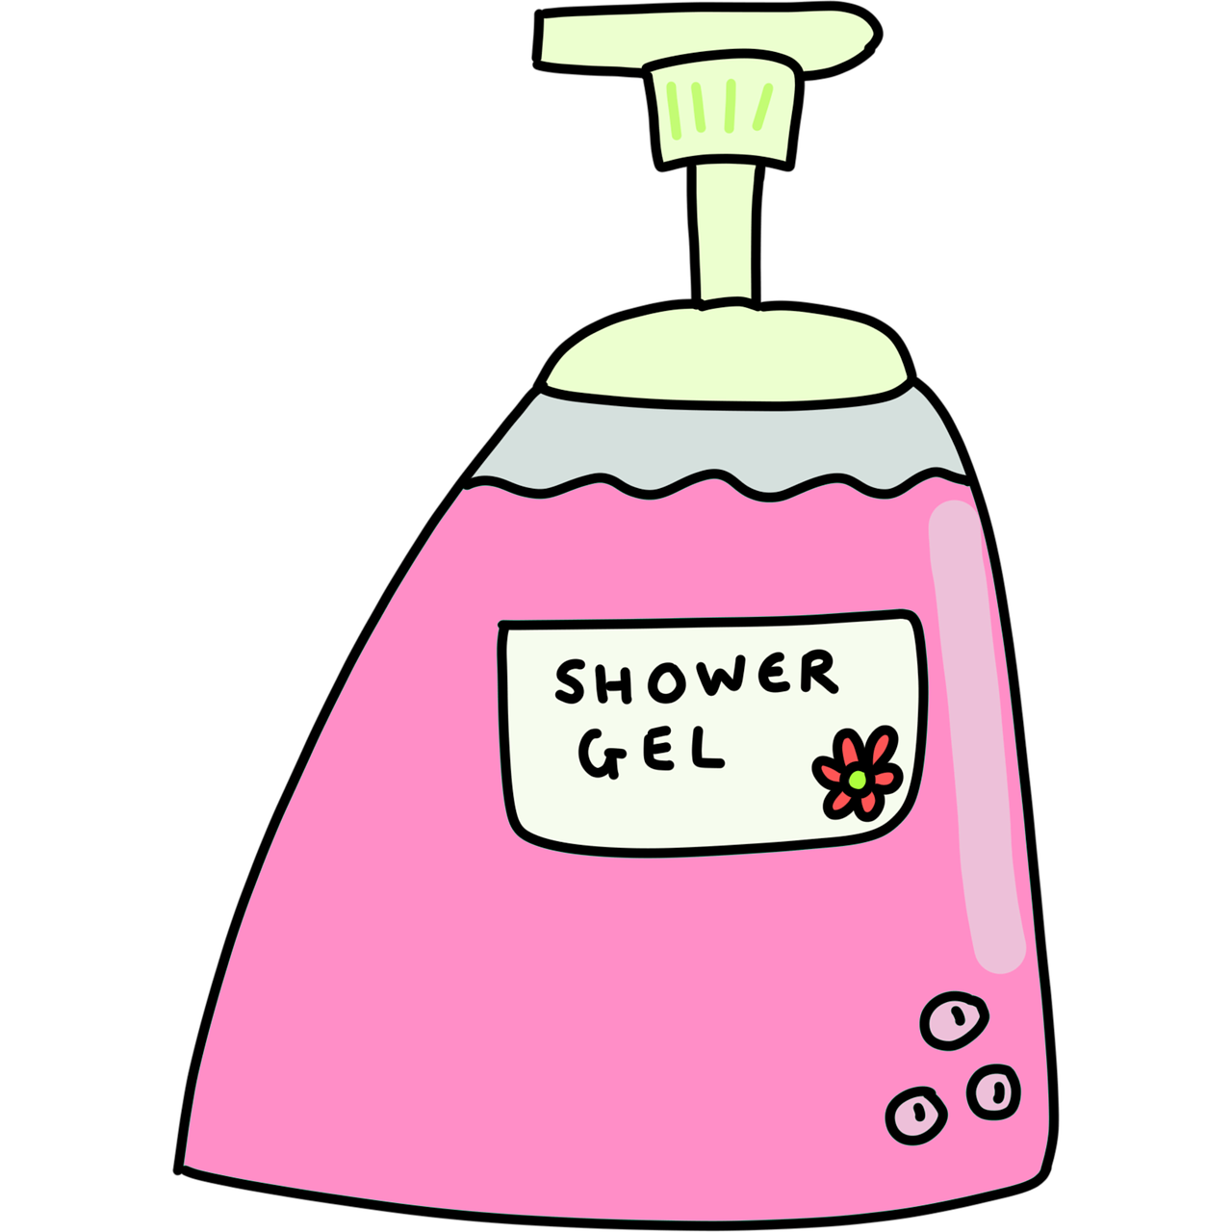
Who is this?
S
N

Slide 17
snow angels
Answer
s + Noah + n + gels

Slide 18
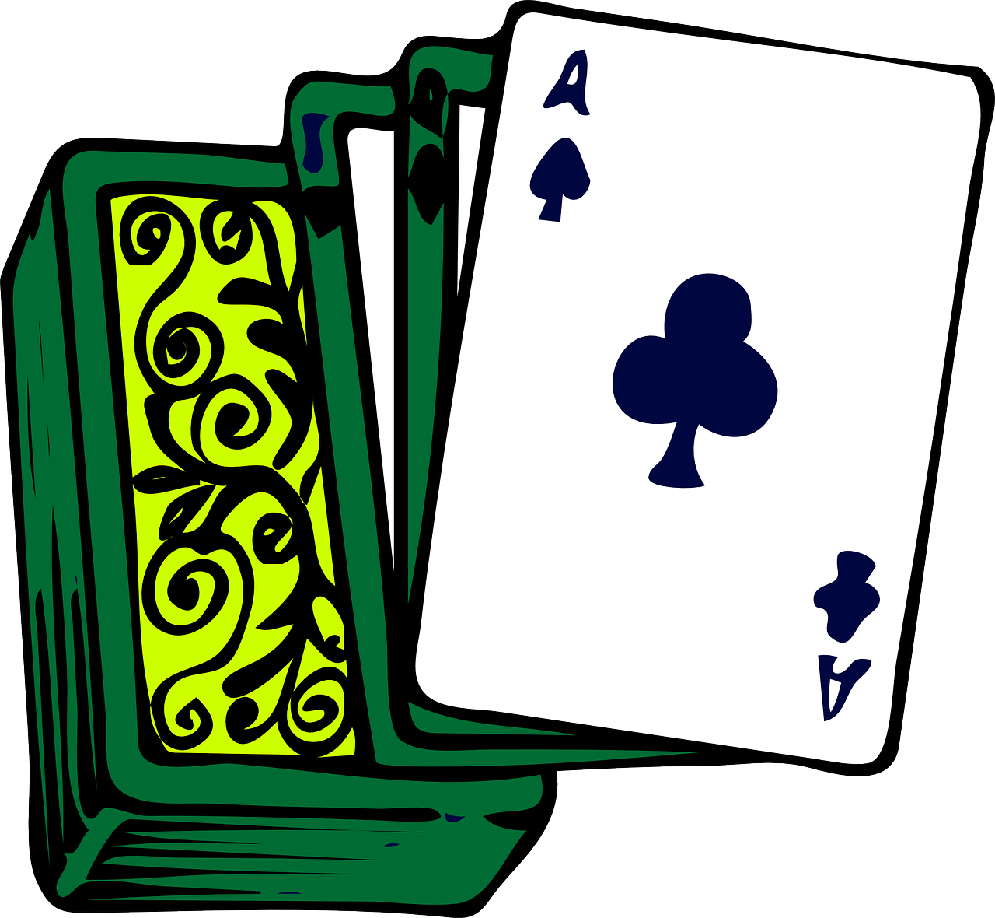
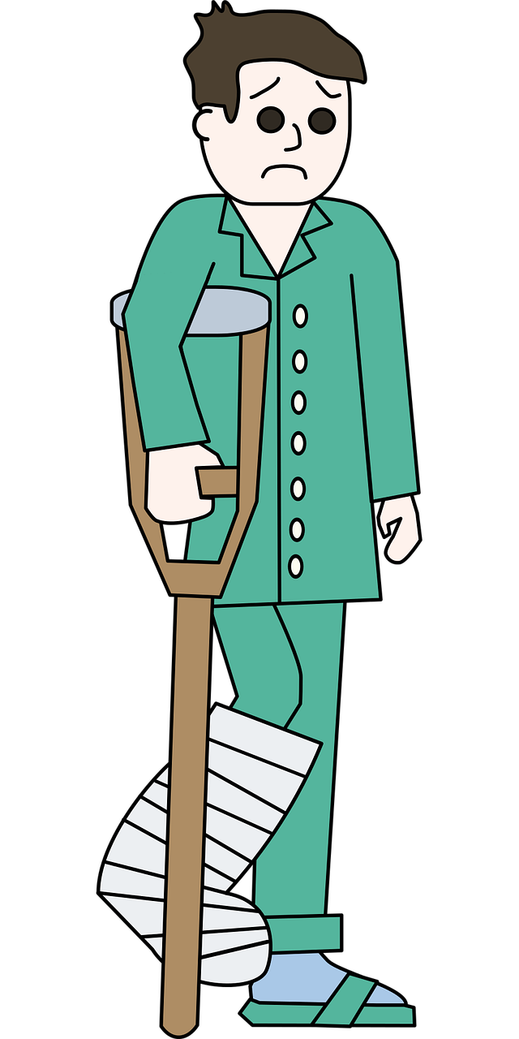
( - P )

Slide 19
decorations
Answer
deck + core + (-p)atients

Slide 20
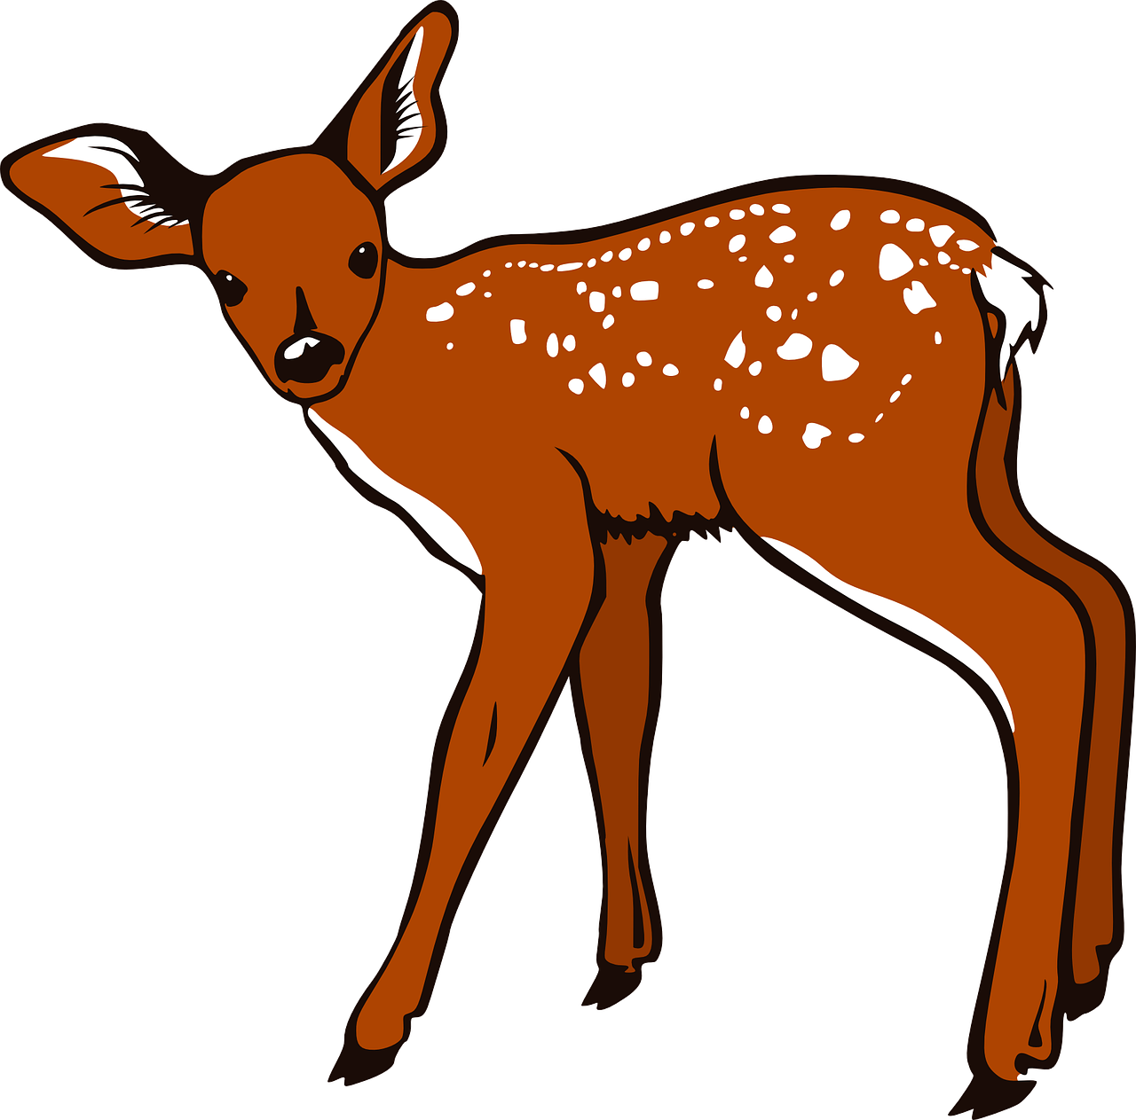
the
F

Slide 21
Elf on the Shelf
Answer
L + fawn
the
shell + f

Slide 22
That’s all!
How many did you get?

