Slide 1
Past Continuous Rules
While
Time in past
While subject + was/were + VERBing, subject + past simple/continuous.
While you were reading, I finished my homework.
Time in past + subject + was/were + VERBing.
(Used to show an action that was happening over a period of time in the past.)
At 5 o'clock yesterday I was reading a book.
I was studying all weekend.
When
When subject + past simple, subject + was/were + VERBing.
When my brother arrived, grandma was making dinner.

Slide 2
Fill in the Blanks
When Raul _____ home, we were drawing.
When the teacher ________ the classroom, Cindy was jumping up and down.
I read a book while Dana _______ work__.
_________ you were sleeping, I fed the dog.
He was cooking _______ you arrived home.
When I went to the movies, they _______ still readi__.
On Thursday at 7 o’clock he ________ go__ to school.
Meiling went home while we ______ cook__.
All Thursday Oscar _____ sleep__.
_____ you were reading your book, she fell down.

Slide 3
Flying House - Up
Watch the video
https://www.youtube.com/watch?v=xVgxeuK7i90
Write down as many sentences as you can using the following pattern.
When the house flew by, SUBJECT + was/were + VERBing.

Slide 4
Answer the Questions
What was the little girl doing when the house flew by?
What was the family with reddish-brown hair doing when the house flew by?
What was the worker doing when the house flew by?
What was the weather like while the house was flying?
What was the old man doing when there was a knock at the door?
What was Russel doing before the house took off?
What was Russel doing when Mr. Frederickson found him?

Slide 5
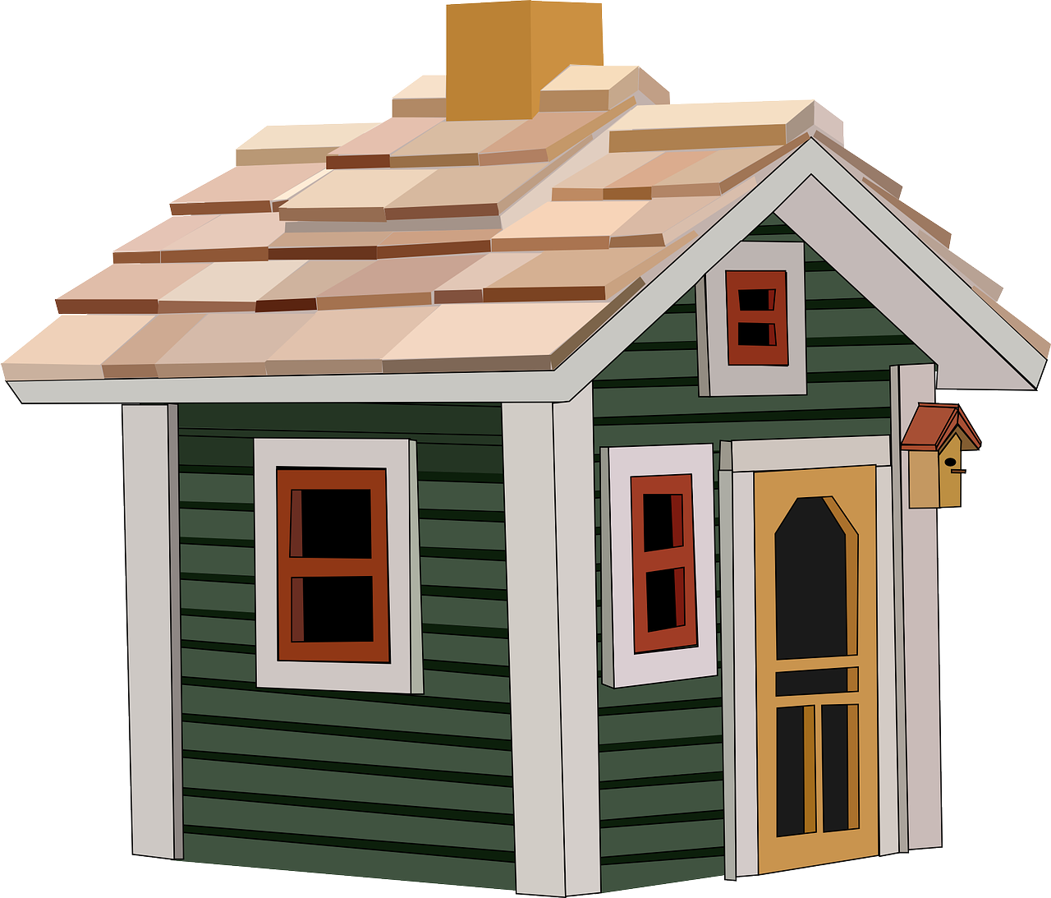
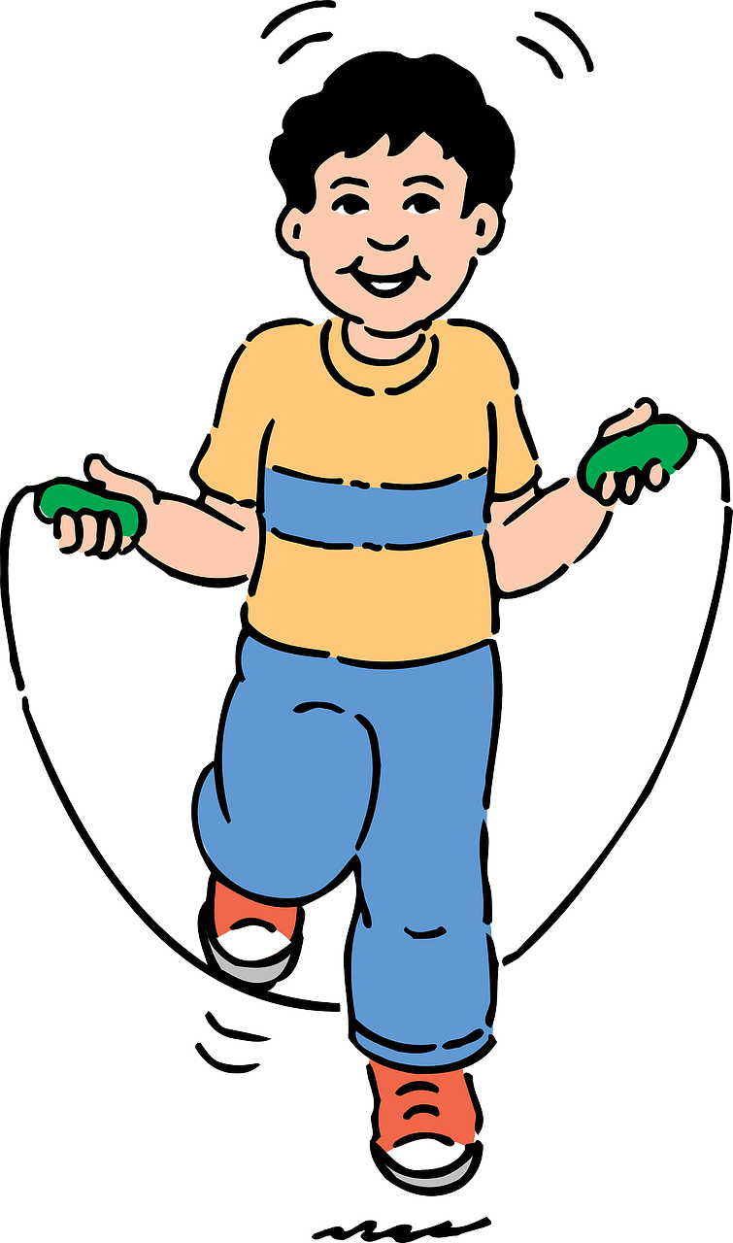
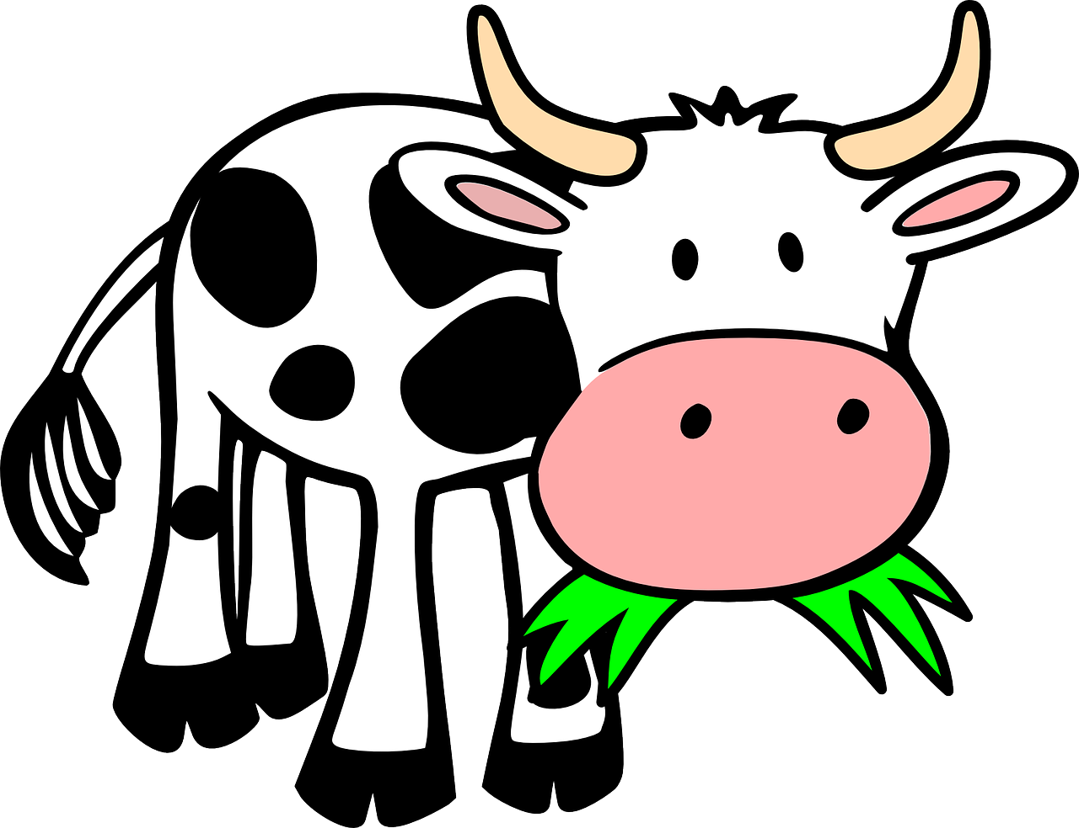
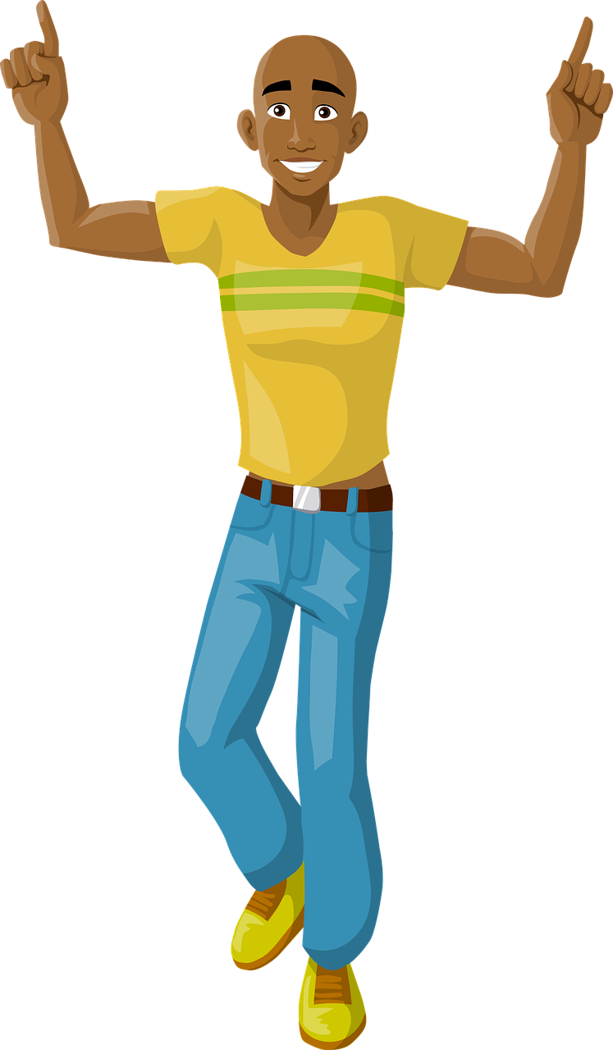
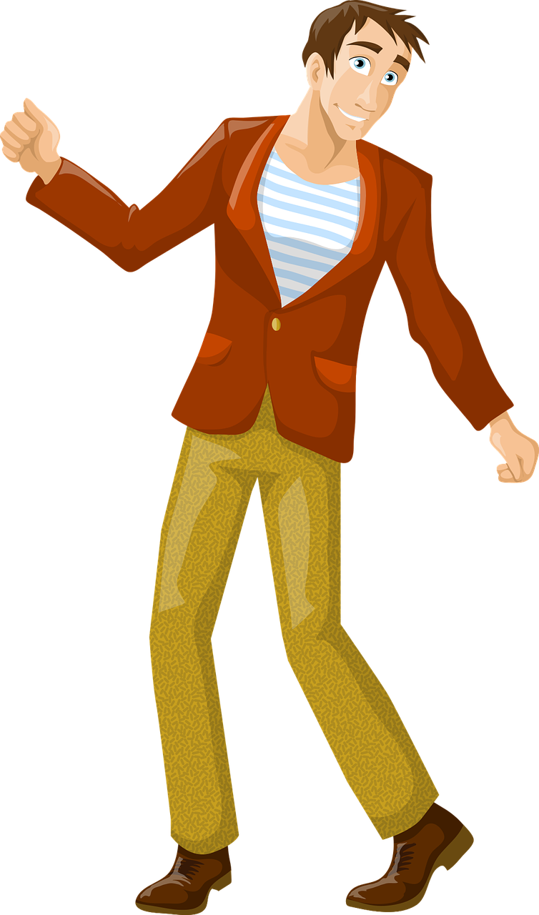
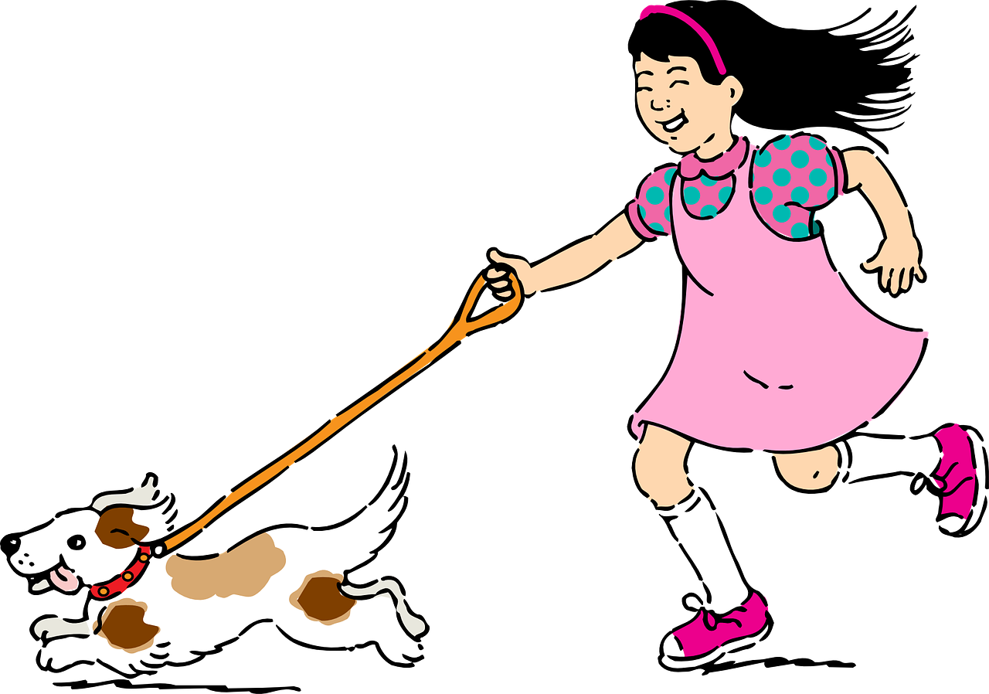
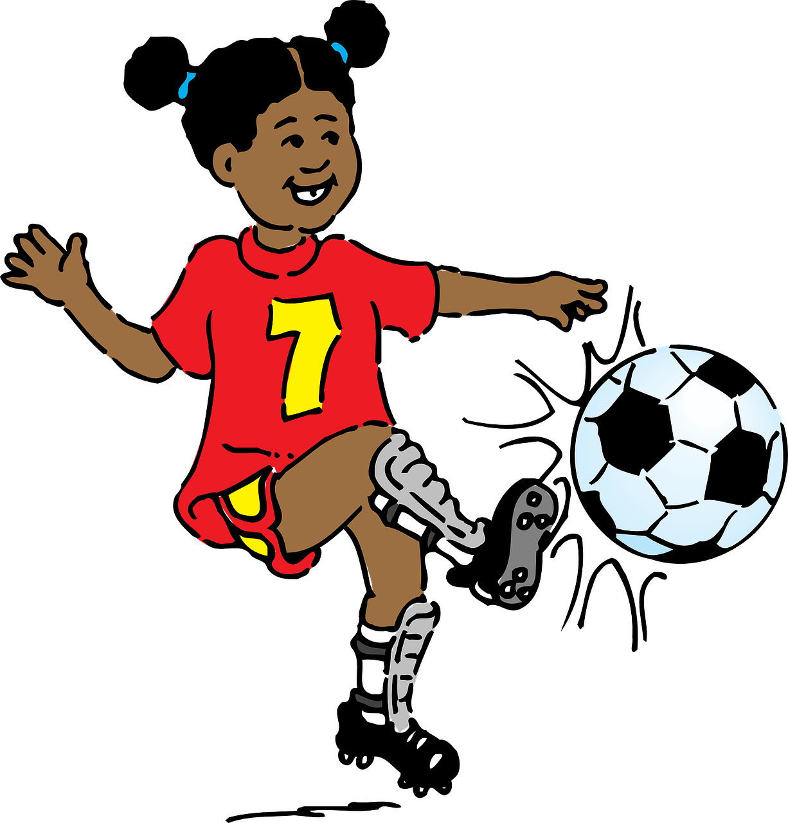
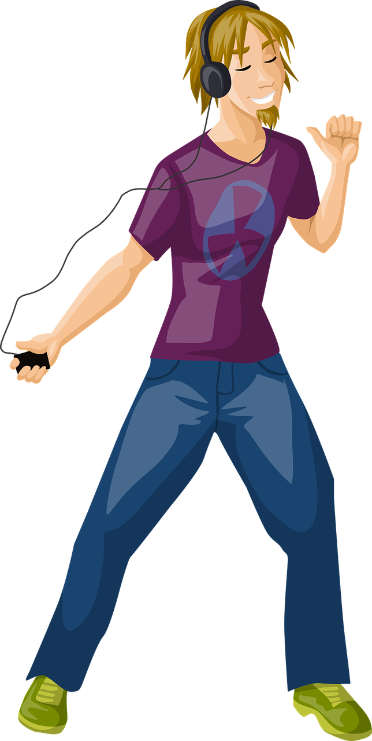
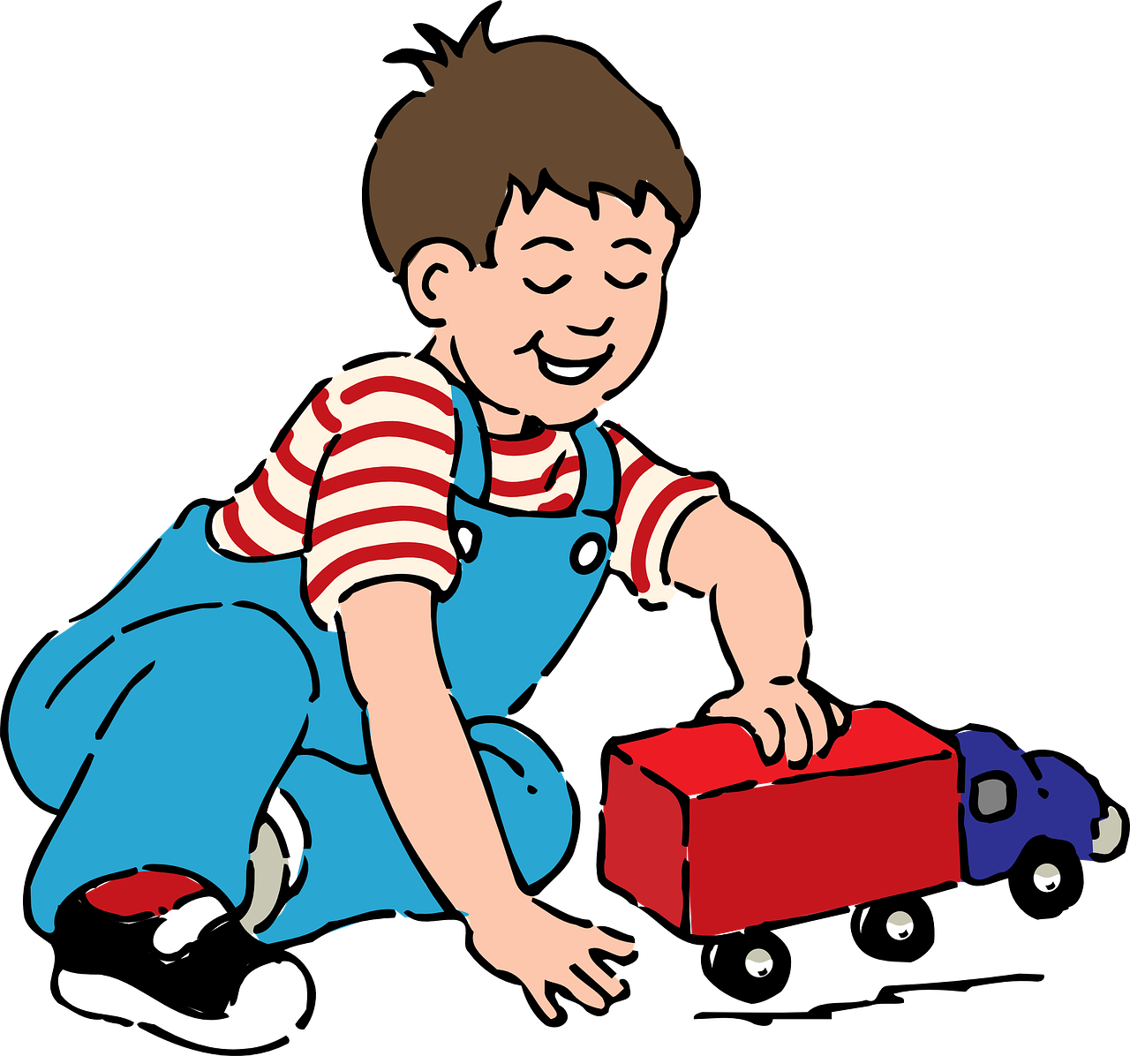

Slide 6
Discussion Questions
What were you doing before class started?
What do you think your teacher was doing before class started?
While you were in class, what were your family members doing?
Were you multitasking (doing more than one thing at a time) during class?
If yes, what were you doing?
What were you doing at 7 p.m. yesterday?
What were you doing at noon yesterday?
What were you doing in the morning yesterday?
Were you sleeping at midnight last night?
Were you studying English somewhere else before you started taking this course?
Were you studying English when you were a child?

Slide 7
Surface Pressure - Encanto
Watch the video
https://www.youtube.com/watch?v=tQwVKr8rCYw
Raise your hand when you can make a sentence using the following pattern. Make as many sentences as possible.
While Luisa was singing, she…

