Slide 7
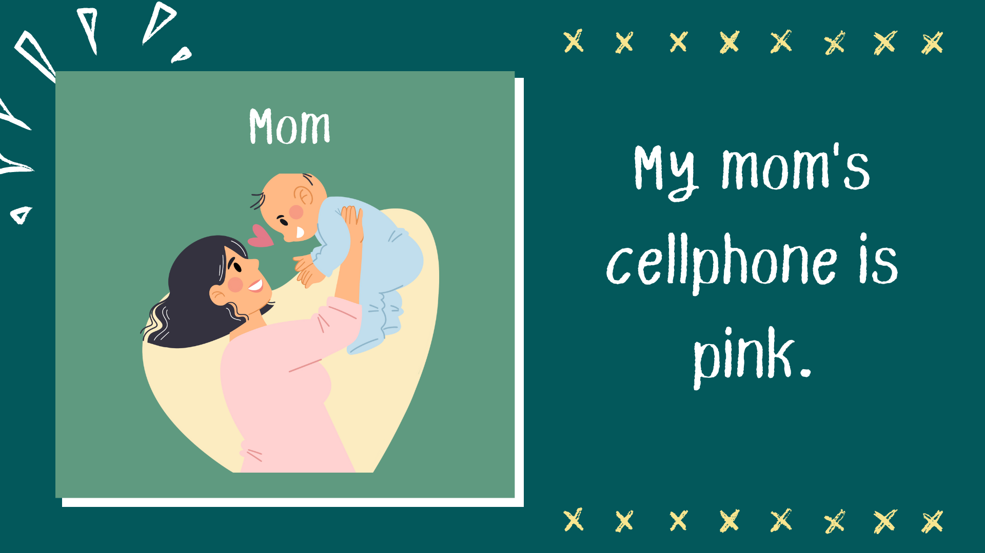

Slide 10
My friend’s dog is so cute

Slide 12
Can I borrow your eraser?

Slide 14
My brother’s pens are blue

